Slide 1
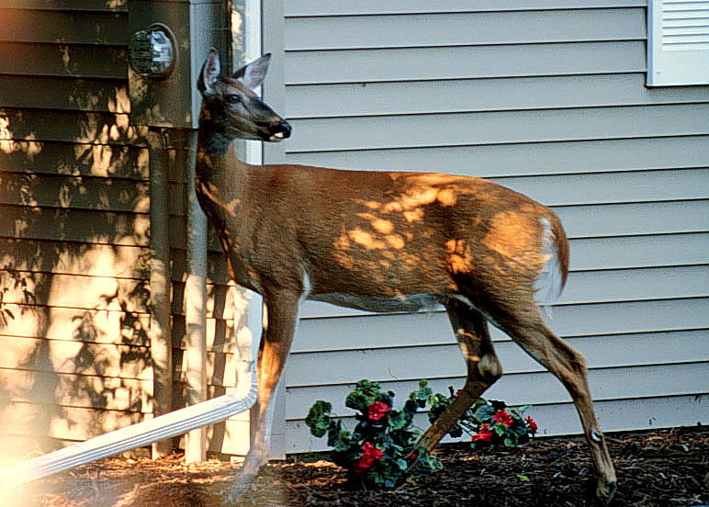
Community-Based Deer Management
Art Kirsch
NYSDEC Region 8

Slide 2
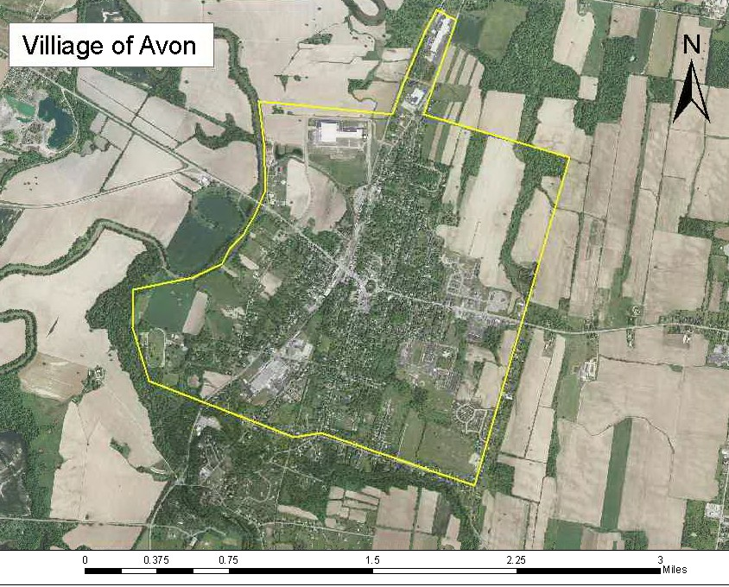
Is there a problem?

Slide 3
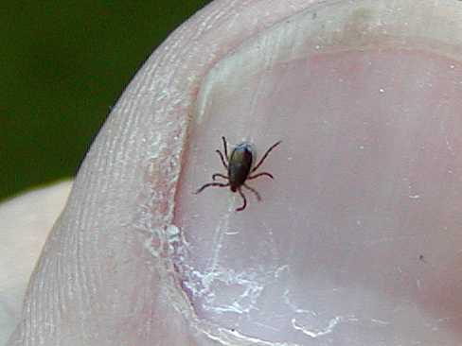
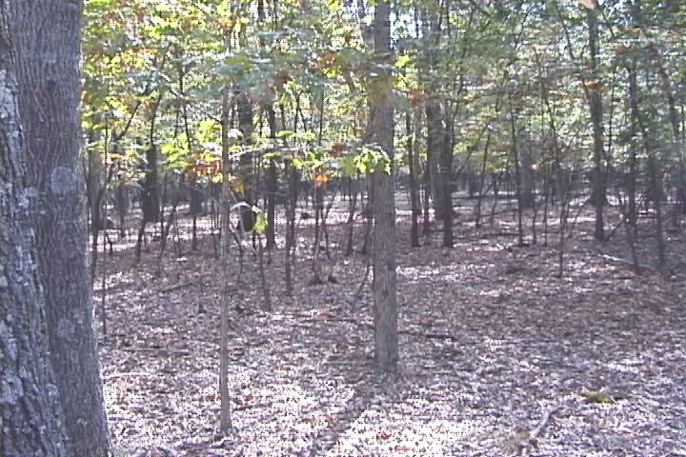
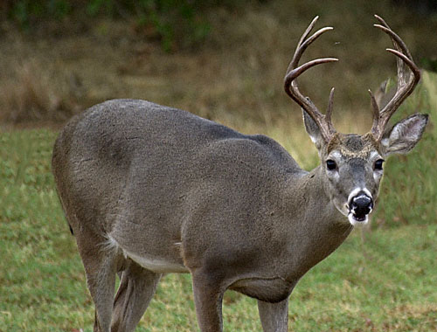
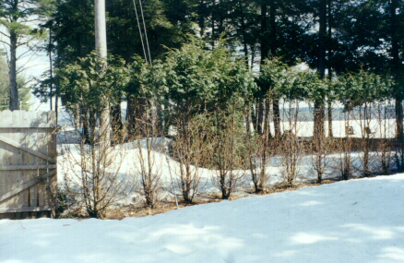
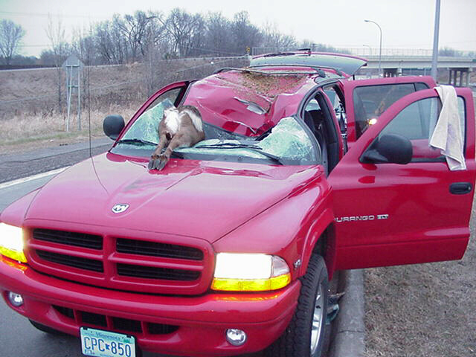
The Traditional Concerns
Ornamental damage
Deer-related vehicle accidents
Ecological damage
Aggressive deer (rarely)
Disease transmission

Slide 4
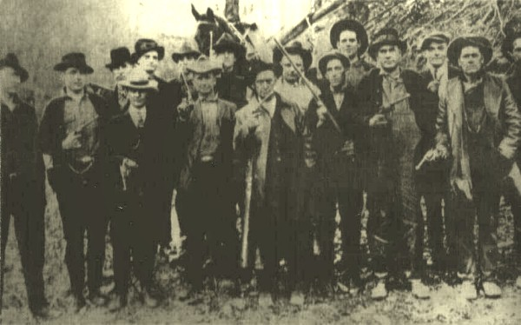
If everyone is in agreement as to the course of action, then by all means, round up the posse!

Slide 5
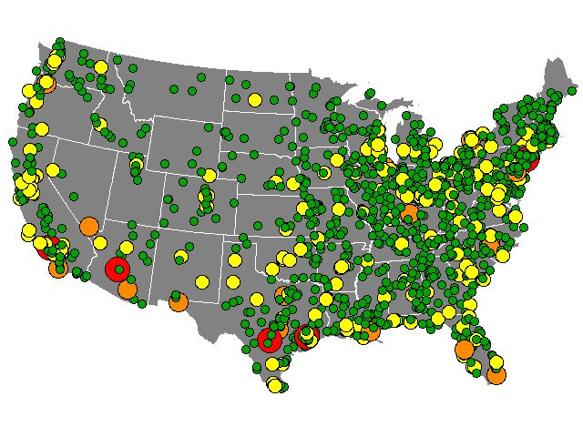
But if Avon is like the other 493 communities in the US who have experienced urban/suburban deer problems over the last 30 years,
the social aspects of the issue will be as important to address as the biological, and should come first.

Slide 6
How to Guarantee That Efforts to Solve a Community Deer Issue Will Fail
Include only one or two perspectives
Have no structured decision-making process
Skip right to the action phase
Ignore people’s opinions
Have no real ground rules
Don’t consider who your stakeholders are
Keep information to yourself
Ignore pertinent information
Harbor hidden agendas
Give up when the going gets a little tough
Expect a “magic bullet” that you only need to take once
Don’t learn from your successes and failures

Slide 7
Essential Elements for Success
Include multiple perspectives
Create a structured decision-making process
Form universally accepted ground rules
Identify your stakeholders
Share understandings among stakeholders
Build a shared, comprehensive information base
Foster full disclosure of stakeholder goals
Believe that acceptable solutions are worth seeking
Understand that community-based deer management is an ongoing process, not a one-time event
Commit to systematic evaluation of the decision-making process and subsequent management program

Slide 8
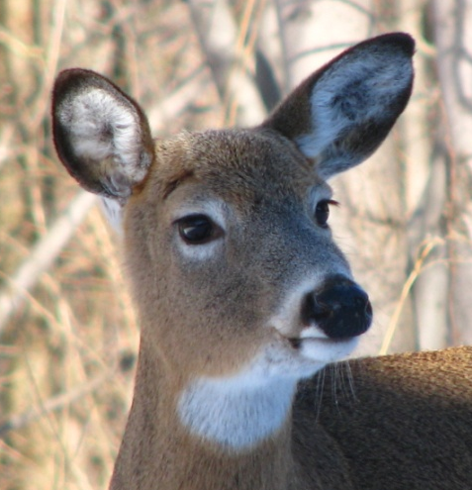
The Community-Based Deer Management Process
Should relate to the problem
Should be easily measured
Does not necessarily require knowing how many deer live in the community
Recognition of problem
Definition of Objectives
Identification of acceptable methods
Selection of options
Implementation
Evaluation
Fencing
Repellents
Planting recommendations
Fertility control (experimental)
Managed hunting
Damage permits
Bait and Shoot
Trap and transfer
Other
High awareness of the issue within the community
Consensus within the community that a problem exists and something should be done
Clarification of just what the problem is
Did actions address and improve original problem?
To what extent?
Were costs on target?
Is community happy?
Any unforeseen neg. consequences?
Can process be made better or more efficient?
Community notification
Who?
When?
Time frame
Who pays?
Safety addressed?
Venison disposition (if deer killed)
Reporting of results
Must be acceptable to the community
Must be affordable
How long will it take?
What is the potential for success?

Slide 9
Reducing Plant Damage
Repellents may work when deer pressure and damage is light
Fencing provides reliable control when deer damage is moderate to heavy
Manage herd density where possible
Deer feeding is illegal in NYS
Choose plants that are less attractive to deer

Slide 10
Plant Palatability

Slide 11
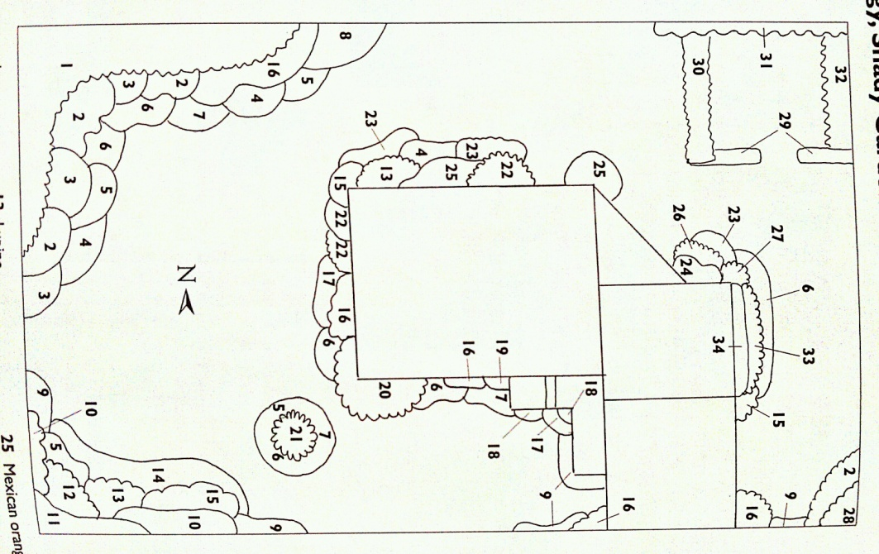
Plan Your Planting!

Slide 12
Factors Influencing Deer Feeding Pressure
Deer population density
Food & cover sources
Travel corridors
Alternative foods
Season & weather
Deer nutrition
Plant palatability & nutrients
Previous experience
Presence of dogs

Slide 13
Repellents
BGR Deer-Away
Hinder
Deer-Off
Chew-Not (20% thiram)
Bonide Rabbit/Deer Repellent
Hot Sauce Repellent
Tree Guard
Other

Slide 14
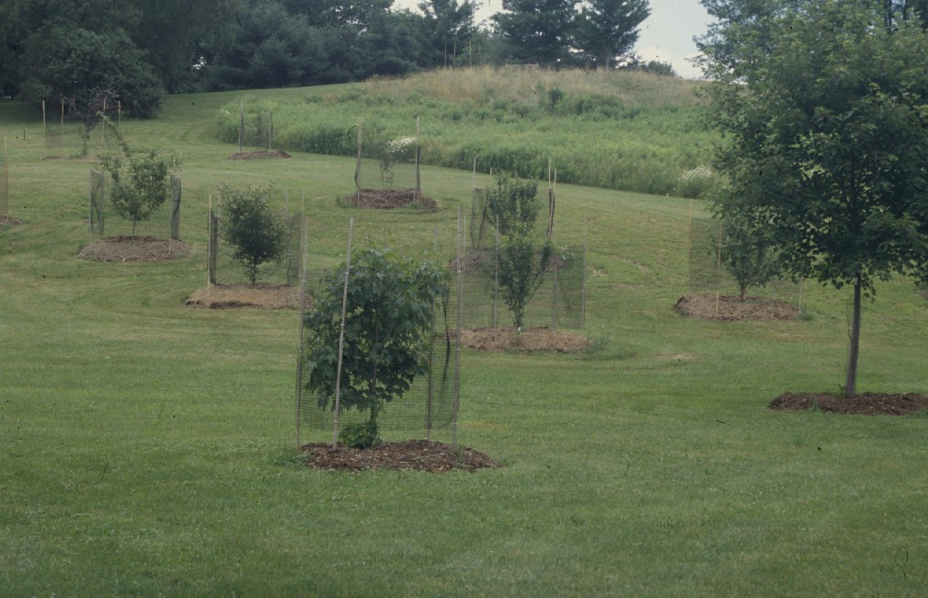
Deer Exclusion Alternatives
8-foot woven-wire fences
Electric fences
Individual plant protection
Dogs

Slide 15
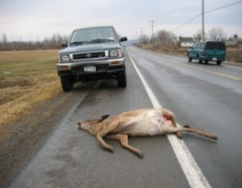
Avoiding Deer-Vehicle Collisions
Driver education
Speed limit reductions and enforcement
Peak months Oct, Nov, and Dec
Be extra careful at dawn and dusk
Heed deer crossing signs; they’re there for a reason

Slide 16
Avoiding Collisions (continued)
Scan the roadsides for eye reflections
Watch where deer came from, not where they’re going
Manage herd density where possible
Do special roadside reflectors work?
What about deer whistles?

Slide 17
Deer Population Reduction
Fertility control
Managed hunting
Deer Management Assistance Program (DMAP)
Deer damage permits
Special urban deer permits (such as bait and shoot)
Trap and Transfer

Slide 18
Fertility Control
Still experimental
Only permitted in communities involved with scientific research
Costly
Does not reduce existing population
Takes years before possible results seen
A one-dose vaccine is being tested, but awaits FDA approval

Slide 19
DMAP
Deer Management Assistance Program
Additional antlerless tags from DEC for use during hunting season
For specific properties
Categories:
Agricultural
Municipality
Significant Natural Communities
Forest Regeneration
Custom Deer Management

Slide 20
Managed Hunting
Landowners have full control of what they allow on their property
Days hunted
Hunt timing
Location
Hunter numbers
Hunter characteristics (ethics, proficiency, trustworthiness, etc)
Can require removal of one or more female deer before buck (“Earn-a-Buck”)
May be discharge of firearms restrictions in place that would limit this option (variance?)
There are ways to address safety concerns

Slide 21
Deer Damage Permits
Site specific
Usually agricultural damage only
To address damage on crops not yet harvested
Usually for antlerless deer only
For use outside of the hunting season

Slide 22
Special Urban Deer Permits
Issued to a municipality
Geared toward population reduction
Covering such activities as “Bait and Shoot”

Slide 23
For more information:
or visit:
www.dec.ny.gov

